Slide 1
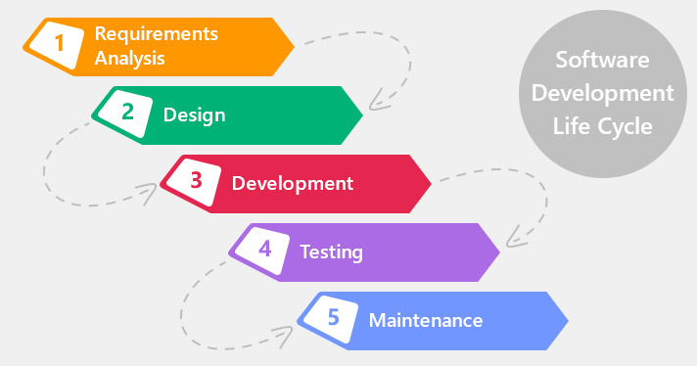
History

Slide 2

History

Slide 3
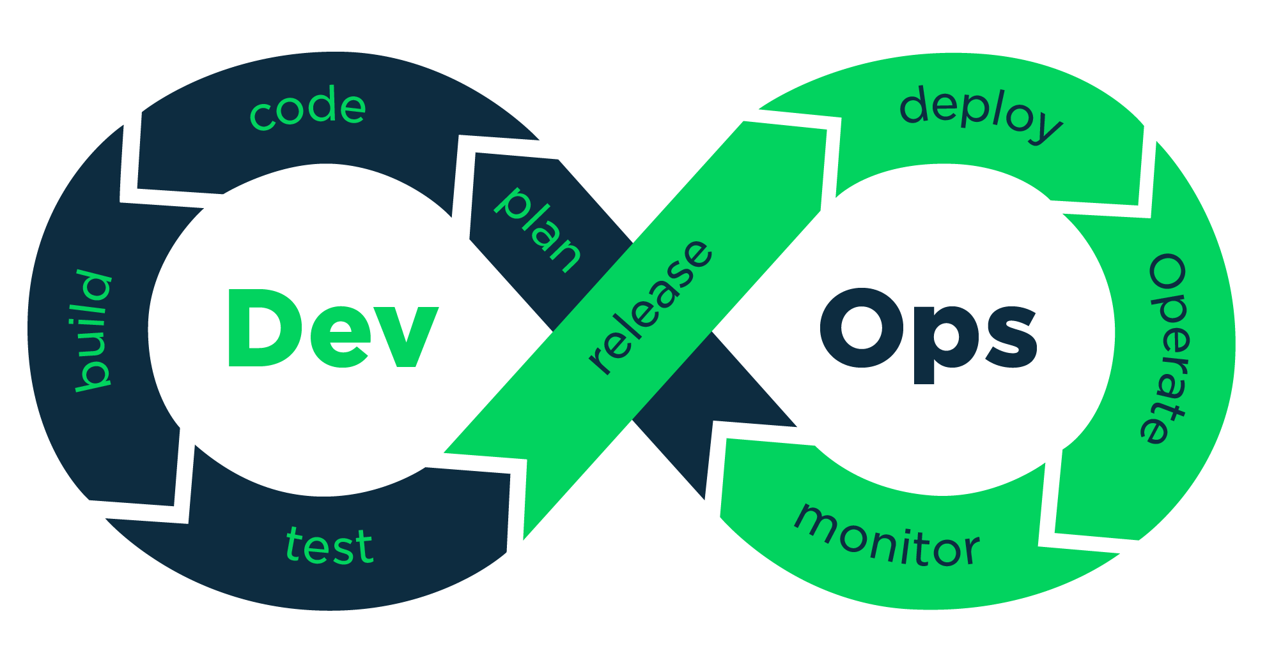
DevOps

Slide 4
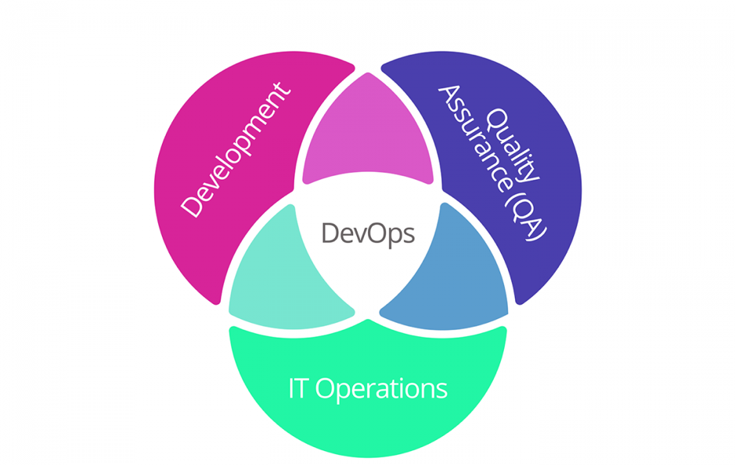
DevOps
A compound of development (Dev) and operations (Ops), DevOps is the union of people, process, and technology to continually provide value to customers. -- Windows Azure

Slide 5
Why DevOps?
Rapid Delivery
Collaboration
Reliability
Reduce friction and team fatigue
Scale
Security

Slide 6
Why DevOps?
Amazon Deploys Code every 1 second
On Android alone, Facebook does between 50,000 and 60,000 builds a day.
Facebook deploy 100 million lines of code daily.

Slide 7
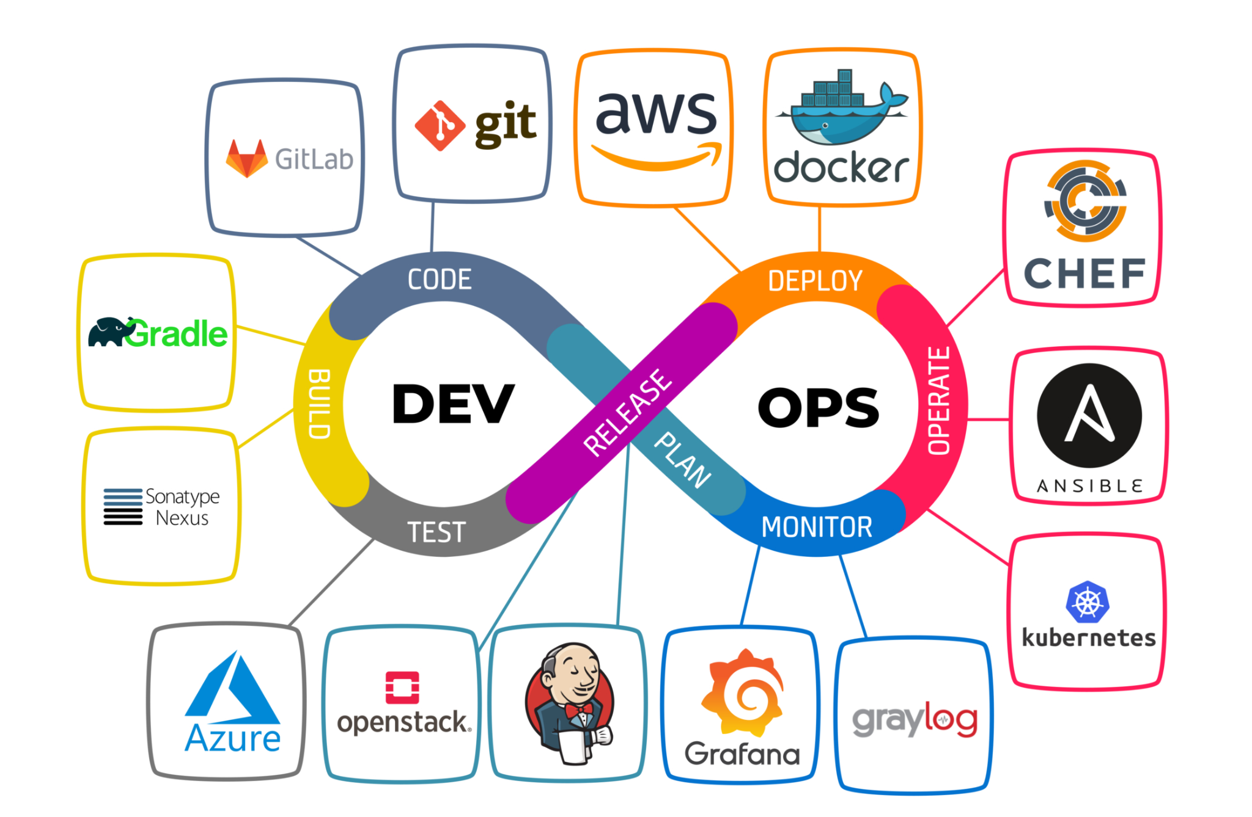
DevOps Process & Tool Chain

Slide 8
Resources
https://aws.amazon.com/devops/what-is-devops/
https://mohamedradwan.com/2016/09/28/what-is-devops/
https://azure.microsoft.com/en-us/overview/what-is-devops/

